Slide 1
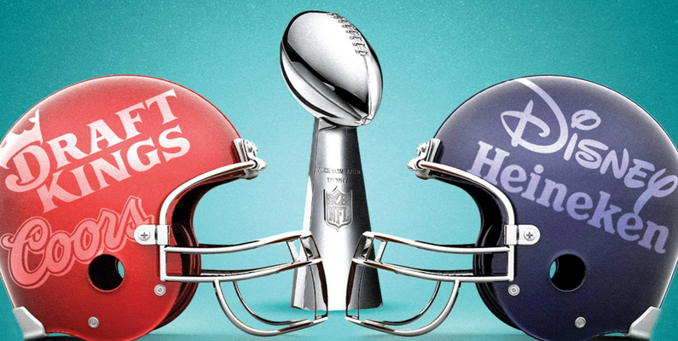
Superbowl Ads
The Super Bowl Ads dataset provides a comprehensive analysis of advertisements that have aired during the Super Bowl, one of the most watched television events in the United States. The Super Bowl is not just a sporting event, but also a cultural phenomenon, attracting a massive audience that is eagerly anticipating the commercials that air during the game.

Slide 2
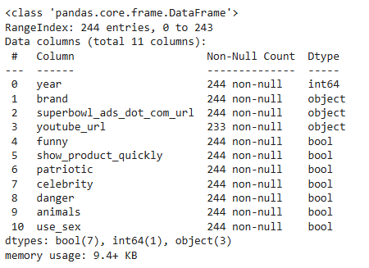
Number of Columns and Datatypes

Slide 3
Companies that have advertised in the Superbowl
Toyota
Bud Light
Hynudai
Coca-Cola
Kia
Budweiser
NFL
Pepsi
Doritos
E-Trade

Slide 4
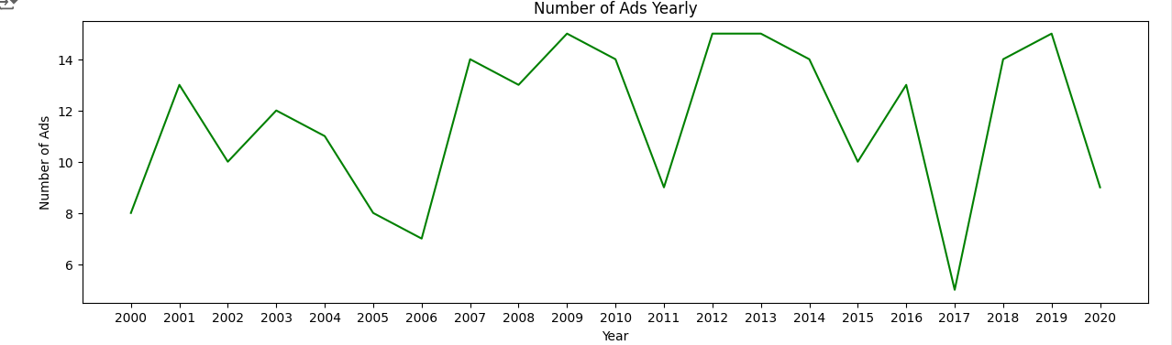
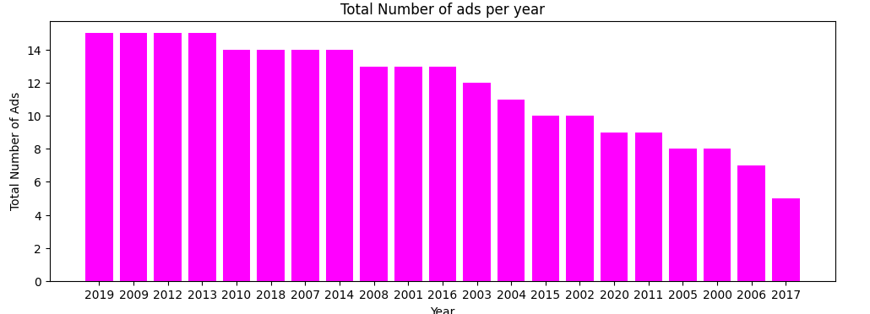
Number of Ads from 2000 to 2020
The ads are from 2000 to 202.
2019, 2009,2012 and 2013 are the years with the highest total number of Ads while 2016 followed by 2017 have the lowest Number of Ads.

Slide 5
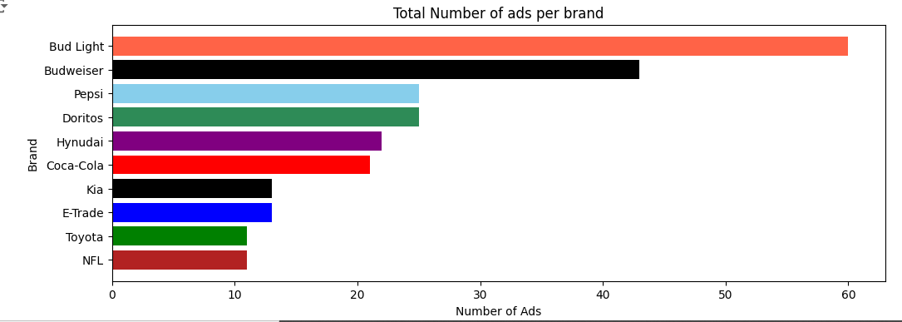
Bud Light has the Highest number of ads since the super bowl Ads started followed by Budweiser. Brands with the lowest counts are Toyota and NFL

Slide 6
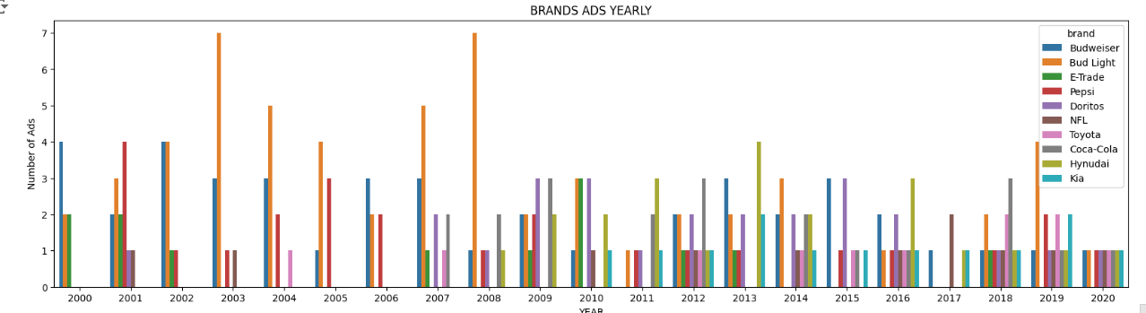
The first brands to advertise at the super bowl are Budweiser, Bud Light and E-Trade. Has been addition brands over the years given opportunities to advertise.
In 2020 each brand is given equal opportunity to advertise, where one brand has been dominating over the years that is Bud Light

Slide 7
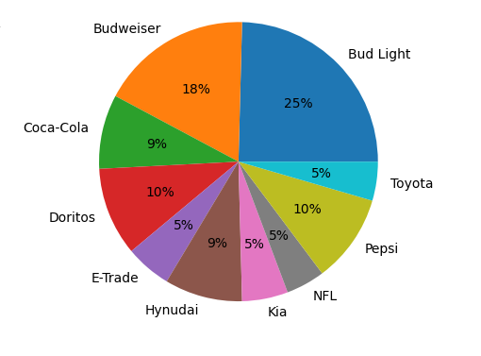
Brands Popularity %
Bud Light has been popular with 25% and Budweiser 18%
While the less popular having 5%, that is E-Trade, Kia and NFL

Slide 8
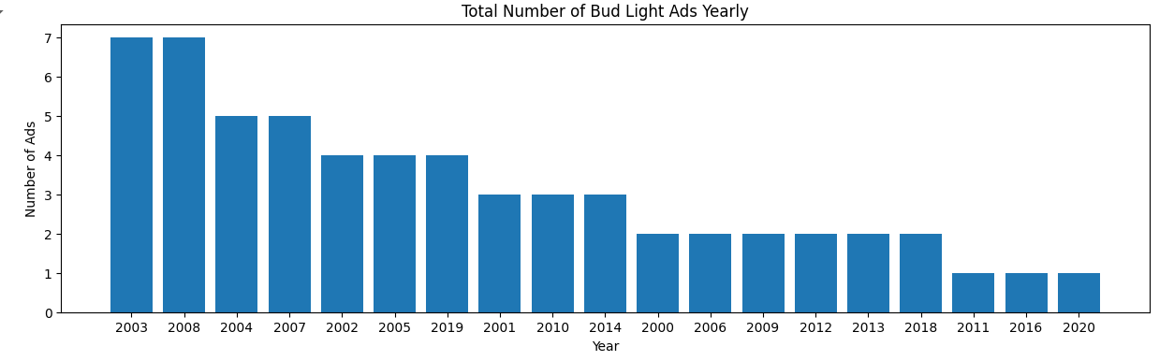
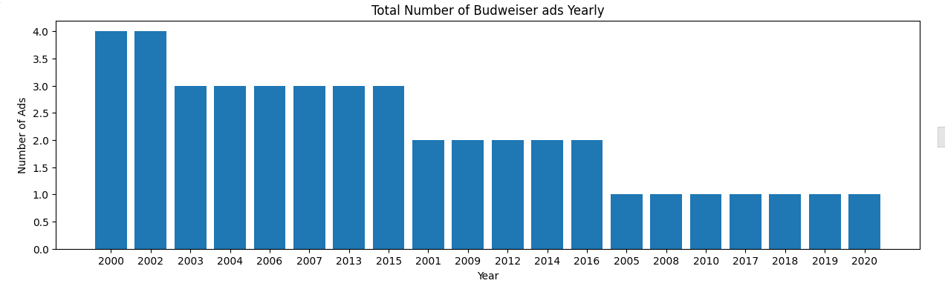
Brands with the highest No. of Ads

Slide 9
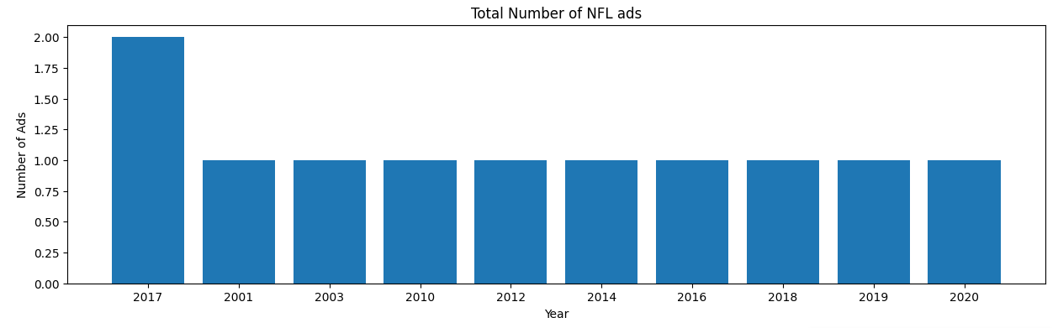
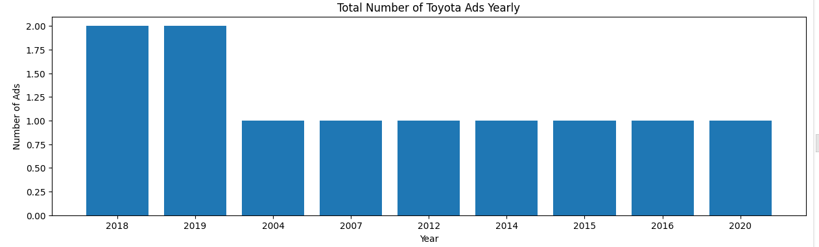
Brands with the Lowest No. of Ads

Slide 10
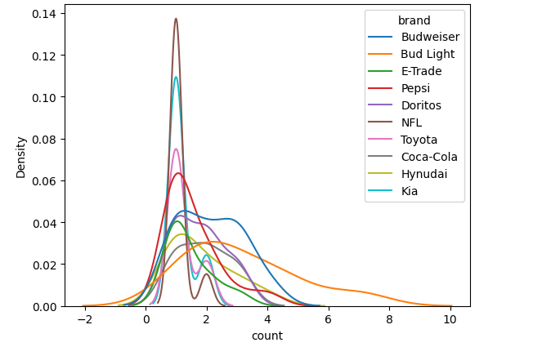

Slide 11
